Slide 1
Tribal Traffic Safety Advisory Board (TTSAB):
“Working Together to Reduce Traffic-related Fatalities and Serious Injuries of Native Americans in Washington.”
October 12, 2018
Scott Waller, Program Manager
Washington Traffic Safety Commission

Slide 2
Objective:
To provide an overview of the Tribal Traffic Safety Advisory Board and present some important data regarding traffic safety priorities in Indian Country.
Purpose:
The Tribal Traffic Safety Advisory Board was created so Tribes and the Washington Traffic Safety Commission could work proactively to reduce deaths and injuries of American Indians and Alaskan Natives in transportation fatalities. The TTSAB has been meeting monthly since 2012.

Slide 3
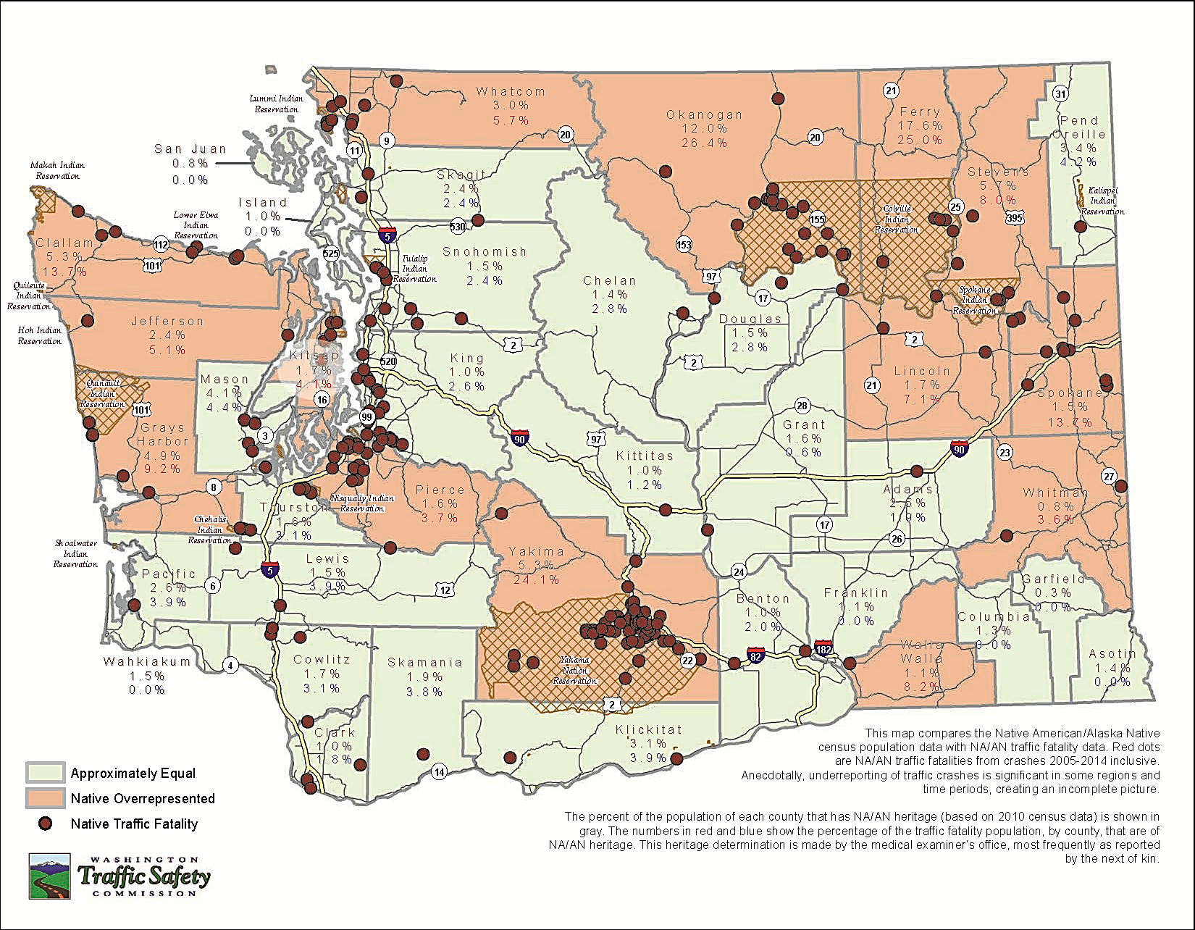

Slide 4
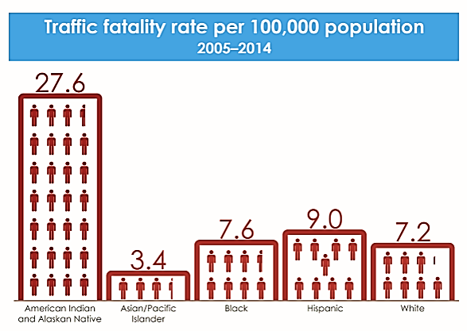

Slide 5
Overall state rate for seat belt use
The occupant was either partially or completely ejected from the vehicle in 80 out of the 122 “No Restraints Used” cases.

Slide 6
Centennial Accord:
The Washington Traffic Safety Commission (WTSC) Centennial Accord mission is to work proactively with tribal governments statewide to reduce deaths and injuries of Native Americans resulting from traffic crashes.
WTSC’s Centennial Accord Plan includes a foundational element of creating a Tribal Traffic Safety Advisory Board (TTSAB) to assist both the tribes and the WTSC in planning and effectively funding traffic safety initiatives focused on reducing traffic related deaths of Native Americans in Washington.

Slide 7
Investments:
Invest financial resources in proven countermeasures to save lives and prevent injuries on tribal lands.
Block grant to the Northwest Association of Tribal Enforcement Officers (NATEO) for law enforcement training and equipment.
Improve crash data on tribal lands.

Slide 8
For more information, contact:
Scott Waller, WTSC Program Manager, (360) 725-9885, swaller@wtsc.wa.gov

